Slide 1
EECS 475: Final Project
Aya Eid

Slide 2
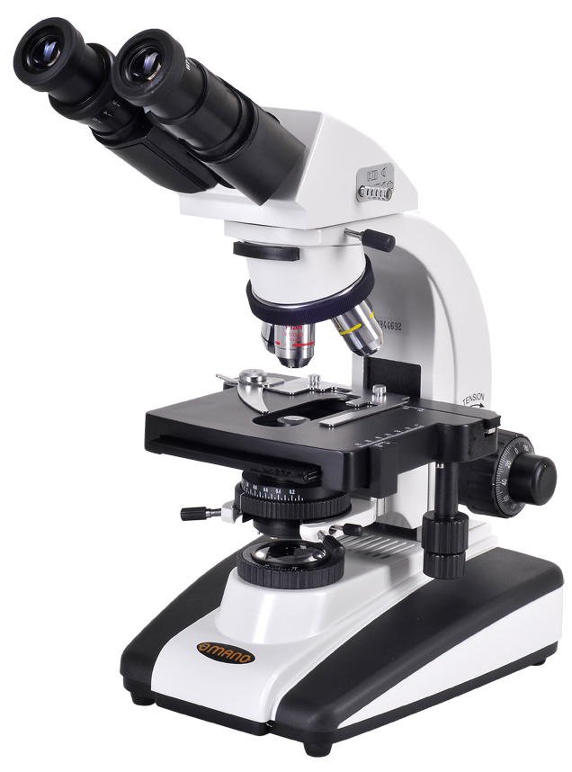
Cheek Cell Nucleus Detection
Given spectral volume
(x,y,z, wavelength) cheek cells
Manually segmented nuclei
Use ML to automatically detect nuclei

Slide 3
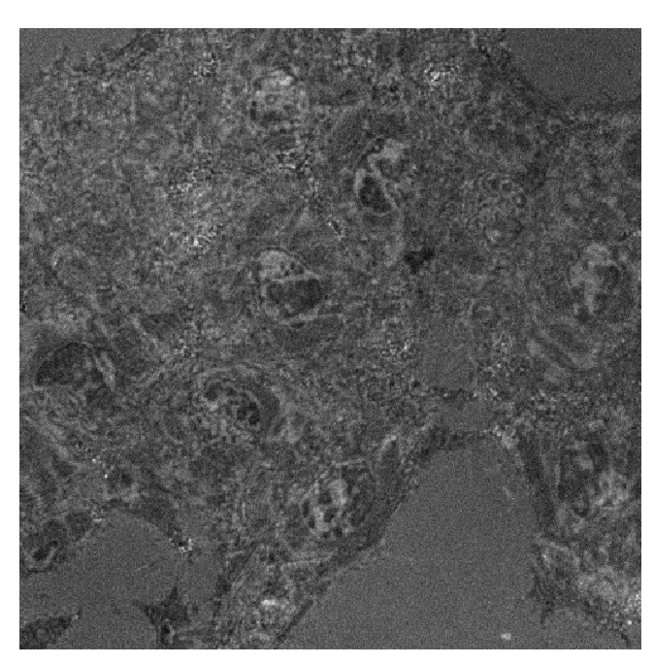
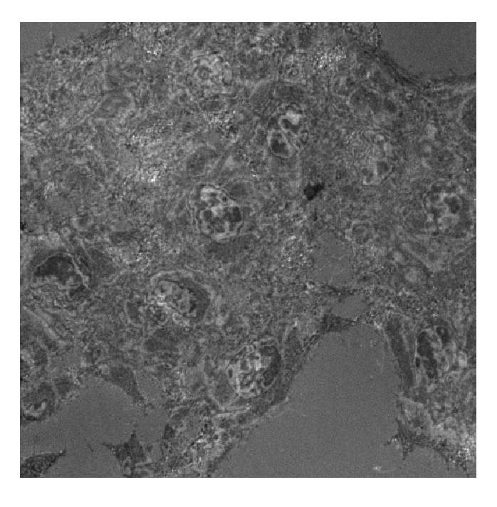
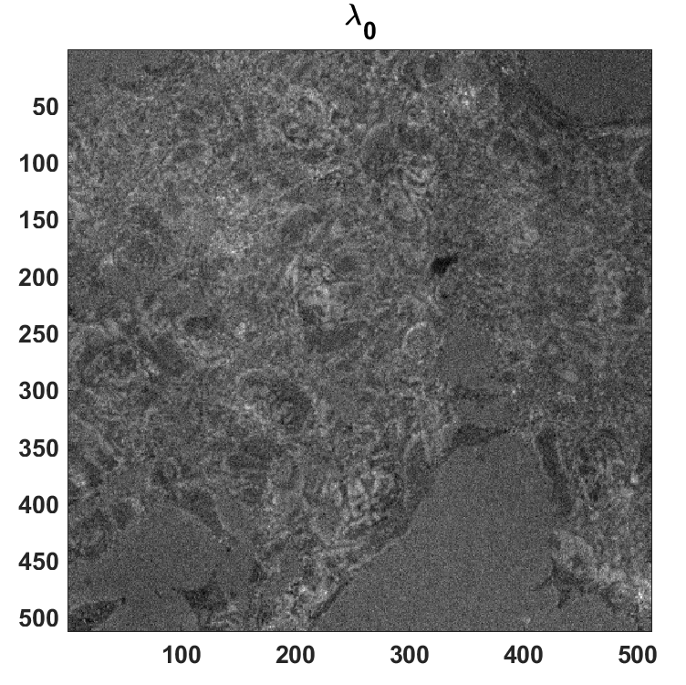
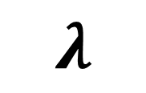
Input Data
$$λ$$

Slide 4

Input Data
+
$$λ$$

Slide 5
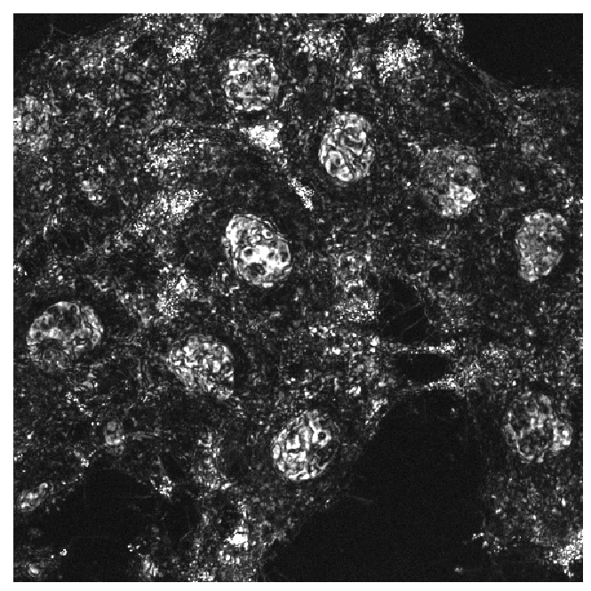
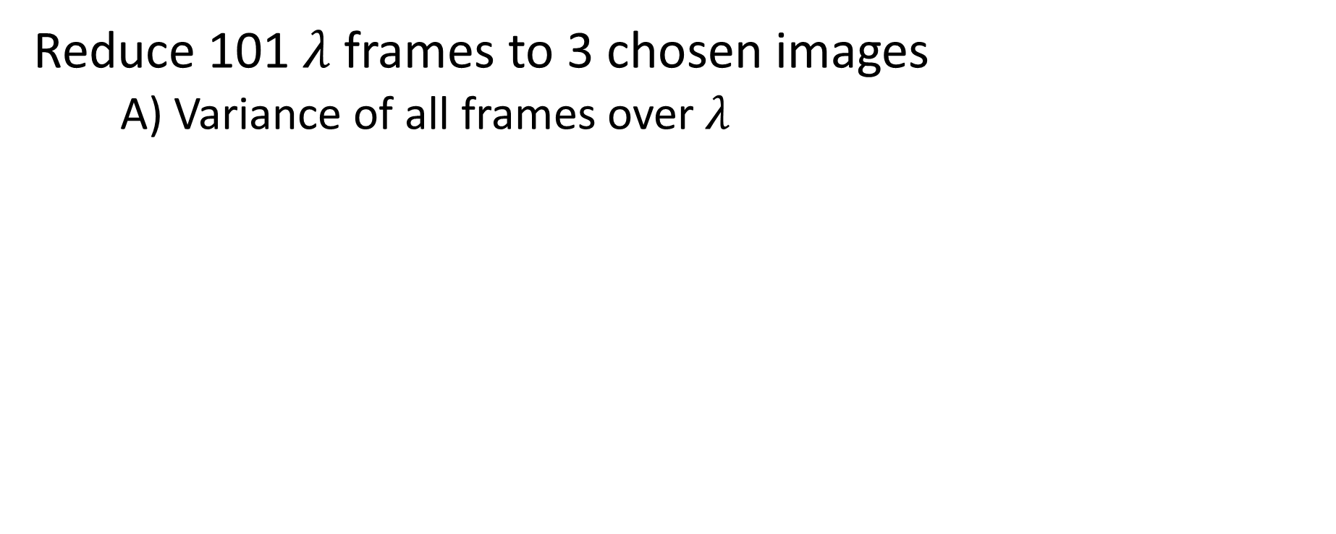
Preprocessing Steps
Reduce 101 $λ$ frames to 3 chosen images
A) Variance of all frames over $λ$

Slide 6
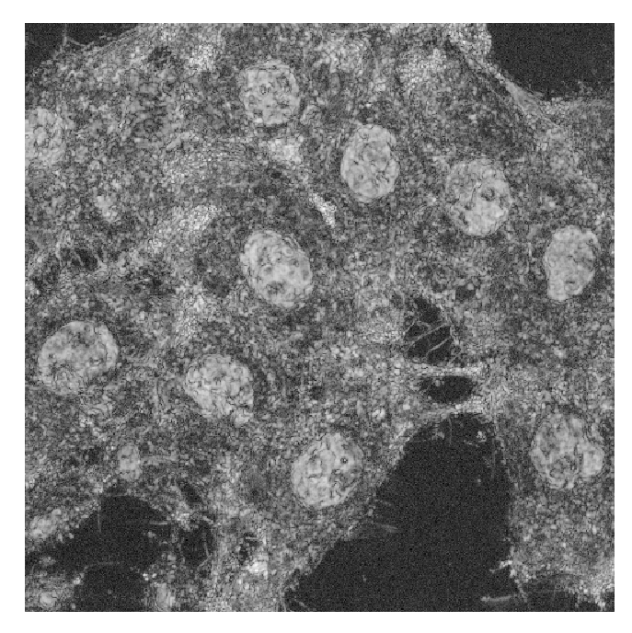
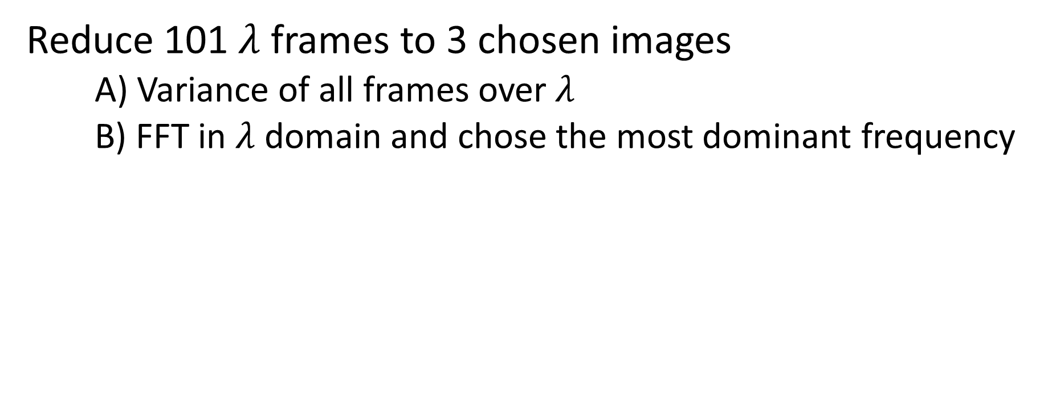
Preprocessing Steps
Reduce 101 $λ$ frames to 3 chosen images
A) Variance of all frames over $λ$
B) FFT in $λ$ domain and chose the most dominant frequency

Slide 7
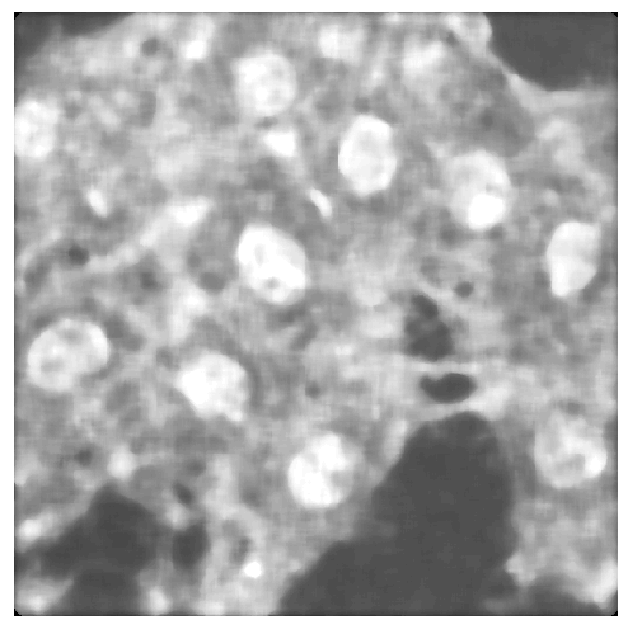
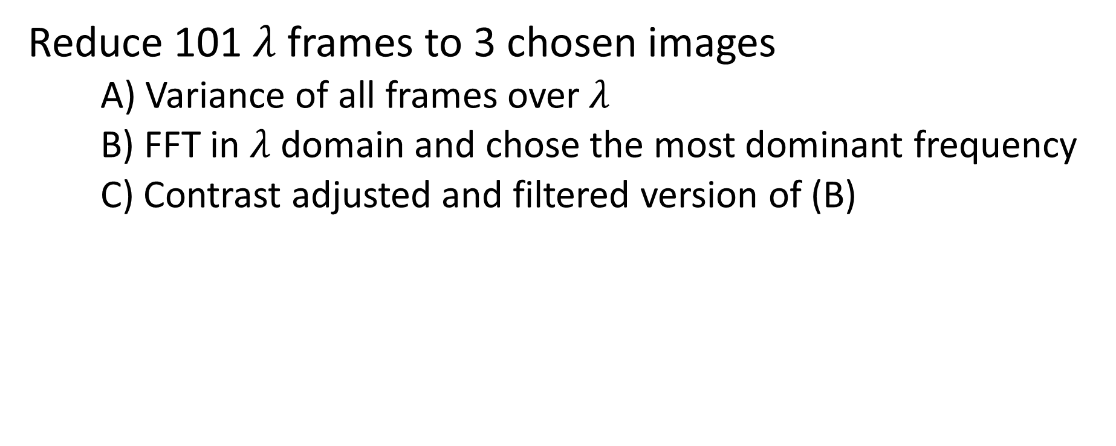
Preprocessing Steps
Reduce 101 $λ$ frames to 3 chosen images
A) Variance of all frames over $λ$
B) FFT in $λ$ domain and chose the most dominant frequency
C) Contrast adjusted and filtered version of (B)

Slide 8
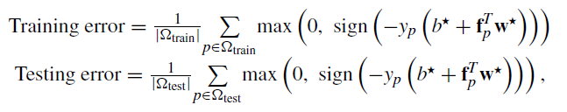
Algorithm
Polynomial basis functions on 3 normalized input parameters
Had 10 images, held out 1 to train the number of features
Least squares to compute weights
Computed error as follows:

Slide 9
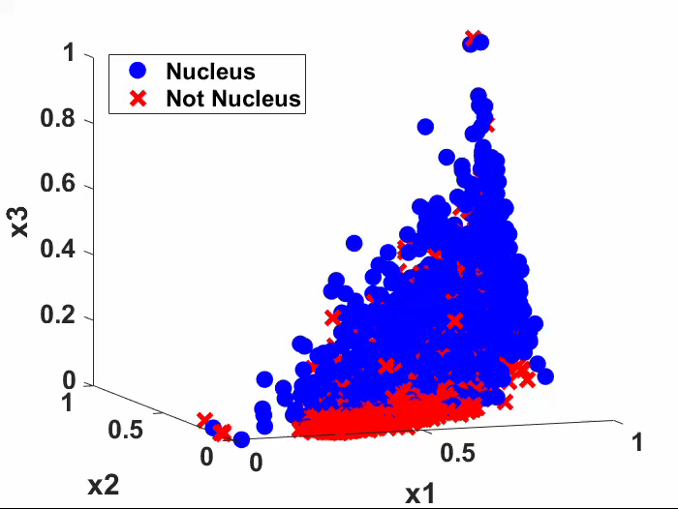
Results

Slide 10
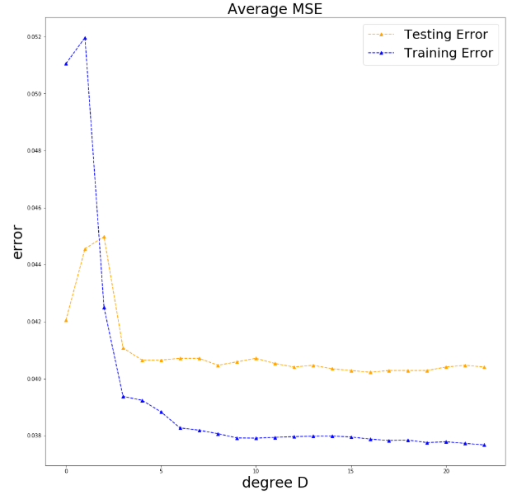
Results
Degree = 8

Slide 11
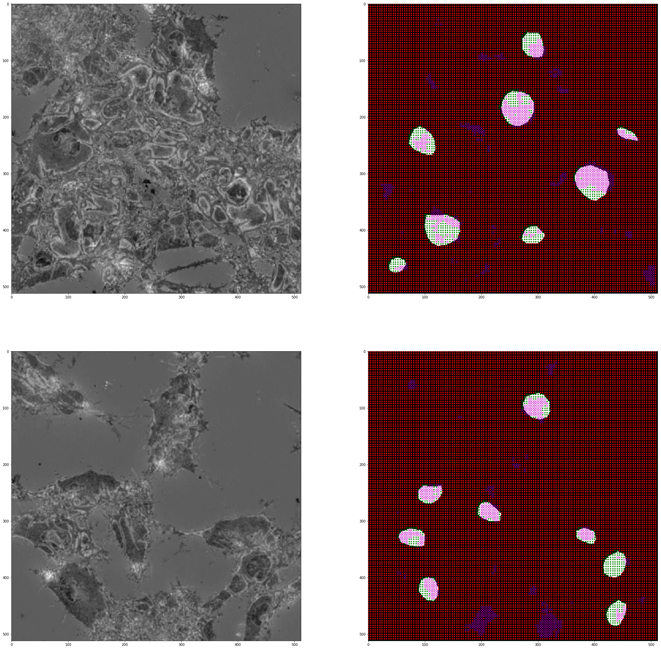
Results
True Positive
True Negative
Training Image
False Negative
False Positive
Test Image

Slide 12
Results
 | Ground Truth
Model |  | - | +
 | - | TN | FN
 | + | FP | TP
Test Results
 | Ground Truth
Model |  | - | +
 | - | 15397/16384 = 0.94 | 328/16384 = 0.02
 | + | 298/16384 = 0.02 | 361/16384 = 0.02

Slide 13
Results
 | Ground Truth
Model |  | - | +
 | - | TN | FN
 | + | FP | TP
Test Results
 | Ground Truth
Model |  | - | +
 | - | 15397/16384 = 0.94 | 328/16384 = 0.02
 | + | 298/16384 = 0.02 | 361/16384 = 0.02
Accuracy = 0.96
Sensitivity = 0.52
Specificity = 0.98
Precision = 0.55

Slide 14
Conclusions
Created a model that yields 96% accuracy in detecting nuclei
Utilized past knowledge in ML
Imbalanced data – more negatives than positives
Spatial information is under utilized
Future: Convolutional Neural Networks

